Slide 1



ONLINE
FRAUD
DETECTIONSYSTEM
By : MOMINA ASLAM 1146,
WARDAH KHAN 1154
ALI IRTZA
0860 , SAAD NASEER 0790
MOHSIN ALI 1158

Slide 2


Table of content
Introduction Work-Related Methodology Applications Conclusion

Slide 3

INTRODUCTION OBJECTIVE:
The goal of this project is to create a machine learning model that can find and identify fake financial transactions. The main aim is to make fraud detection better and faster, helping to prevent financial losses and keep transactions safe.

Slide 4


DATASET
This dataset named “FRAUD DETECTION” is taken from Kaggle
DATA FEATURES
Amount oldbalanceOrig newbalanceOrig oldbalanceDest newbalanceDest isFraud isFlaggedFraud

Slide 5








Input features:
We have taken following as input features:
Target Column:
Targerted column is:

Slide 6


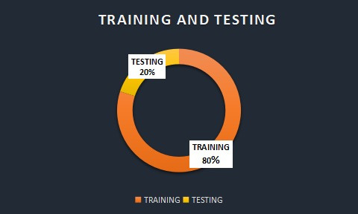
TESTING AND TRAINING

Slide 7




TOOLS AND TECHNOLOGY:
· Programming Language:
Python
· Libraries:
Data Manipulation: Pandas, NumPy Data Visualization: Matplotlib, Seaborn Machine Learning: Scikit-learn
· Environment: Jupyter Notebook

Slide 8
RELATED-WORK
Data Preprocessing: Techniques specific to fraud detection like encoding categorical variables and balancing the dataset. EDA: Identification of fraud patterns and correlations. Feature Engineering: Creating features that highlight anomalies and unusual patterns. Model Training: Specialized algorithms for fraud detection, handling class imbalance. Model Evaluation: Focus on precision and recall due to the importance of minimizing false positives and false negatives.

Slide 9
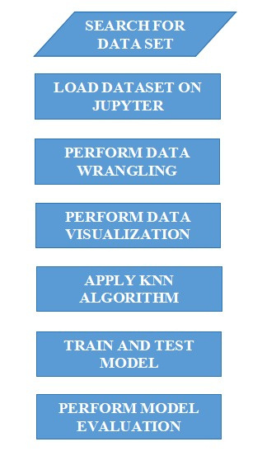
METHODOLOGY
SEARCH RELATED DATASET LOAD THE DATASET PERFORM DATA WRANGLING PERFORM DATA VISUALIZATION APPLY KNN ALGORITHM TRAIN AND TEST MODEL PERFORM MODEL EVALUATION INCLUDING ACCURACY,CONFUSION MATRIX AND CLASSIFICATION REPORT

Slide 10





APPLICATIONS
Banking and Financial Services E-Commerce Healthcare Government and Public Sector Retail

Slide 11


BENEFITS
Cost Savings Improved Security Customer Trust Regulatory Compliance Operational Efficiency

Slide 12
DRAWBACKS
High false positive rate Data quality and availability Computational cost Maintenance and updating

Slide 13



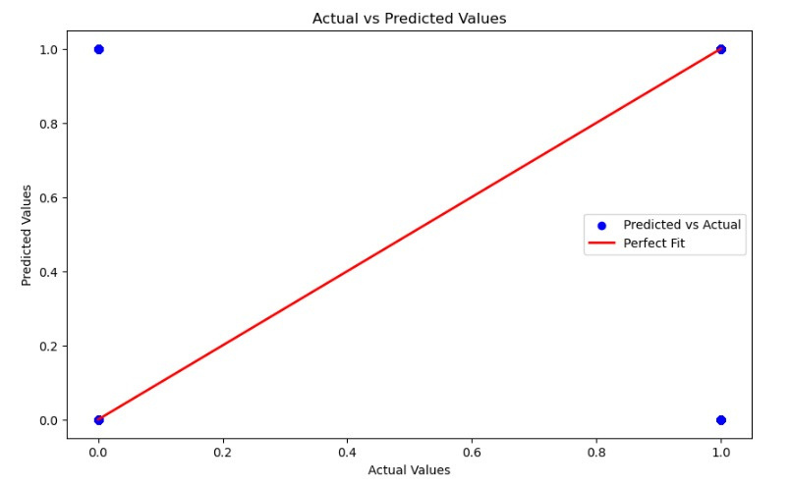
CONCLUSION
The development and implementation of our fraud detection system represent a significant advancement in safeguarding against fraudulent activities This system also improves operational efficiency The accuracy of our prediction is 99%

Slide 14

Thank you.

